Slide 1






$$y=b$$
$$N_{2}$$
$$N_{4}$$
$$y=a$$
$$N_{1}$$
$$N_{3}$$

Slide 2
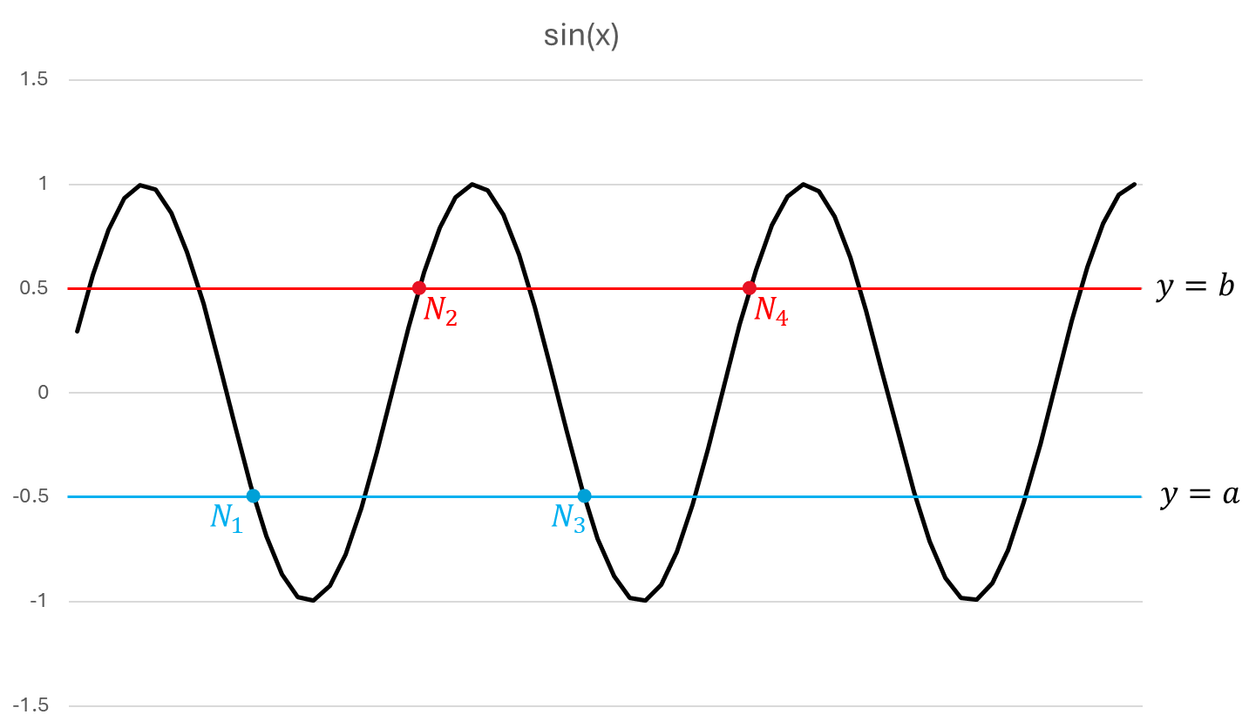

Slide 3





$$N_{2}$$
$$N_{4}$$
$$N_{6}$$
$$y=b$$
$$n_{0}$$
$$y=a$$
$$N_{1}$$
$$N_{3}$$
$$N_{5}$$

Slide 4



$$N_{2}$$
$$N_{4}$$
$$N_{6}$$
$$y=b$$
$$n_{0}$$
$$y=a$$
$$N_{1}$$
$$N_{3}$$
$$N_{5}$$

Slide 5
